Slide 1
RISC-V Floating Point Unit
ECE 571 - Final Project Presentation
Chuck Faber, Bhargavi Chunchu, Ramprakash Baskar, Keerthan Nayak
https://github.com/Keerthan1994/RISC-V-Floating-Point-Processor
Notes:
Chuck

Slide 2
Project Proposal Overview
Develop a Floating point unit for a RISC V processor that does
Addition
Subtraction
Multiplication
Division
Operands are represented in the hardware using IEEE 754 format. Try to implement it into a RISC-V processor.
Notes:
Ram:

Slide 3
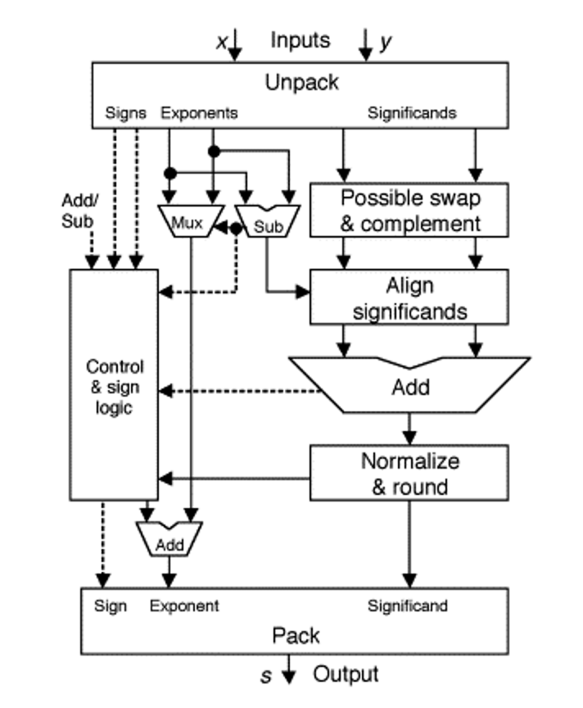
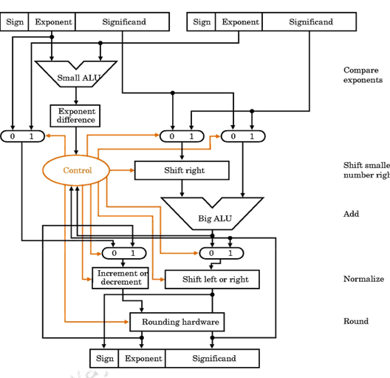
Our Starting Point
*Full References at End of Presentation
Notes:
Bhagi: We found some resources that generally described how IEEE 754 hardware should work, often in simplistic terms. We did not start with any code, and had to implement the designs ourselves.

Slide 4
Who Did What
Chuck and Bhagi worked on the Add/Subtract modules.
Chuck also wrote the packages and testbench.
Keerthan worked on the multiply module.
Ram worked on the divide module and RISCV processor search.
Add/Sub Modules
Mult/Div Modules
Notes:
Keerthan

Slide 5
What We Accomplished
What We Didn’t Get To...
A Single-Precision Floating Point unit with three operations
Addition, Subtraction, Division
A directed random testbench that tests randomized operands of all different corner cases
A weight random testbench that generates FP fields based on set weights.
Standardized error outputs for Overflow/Invalid/Underflow, etc. for some of the operations
“Round to Even” rounding schema.
Multiplier is fixed and working as expected.
Because of the time constraints we could not integrate our FPU into a RISC V processor as we originally planned.
Notes:
Chuck

Slide 6
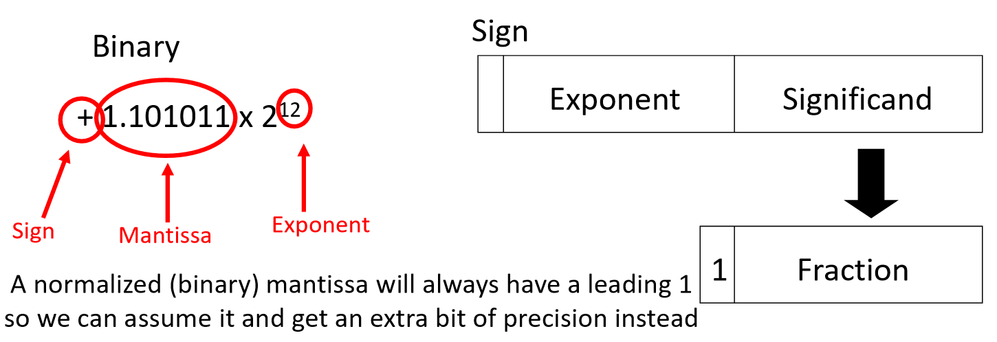
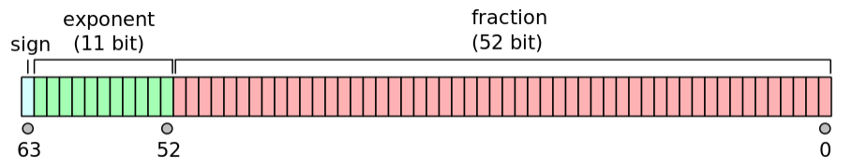
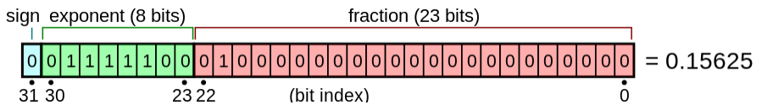
Some IEEE 754 F.P. Review
64-bit Double Precision F.P.
32-bit Single Precision F.P.
Special Cases:
Denormalized Numbers
Infinity
NaN
Zero
Notes:
Bhagi: As a quick review of IEEE 754 Floating Point standard, recall there is double precision floating point which works with 64 bit operands and outputs, and allows greater precision. And there is 32-bit single precision floating point. We implemented 32-bit single precision floating point in our design. The bits of a floating point number are broken out as follows and can represent a decimal number by applying them in the following way. A large part of this project was also trying to figure out how to handle denormalized numbers which don’t include a leading 1 in the mantissa, and special cases like NaN and infinity.

Slide 7
Addition / Subtraction Design Details

Slide 8
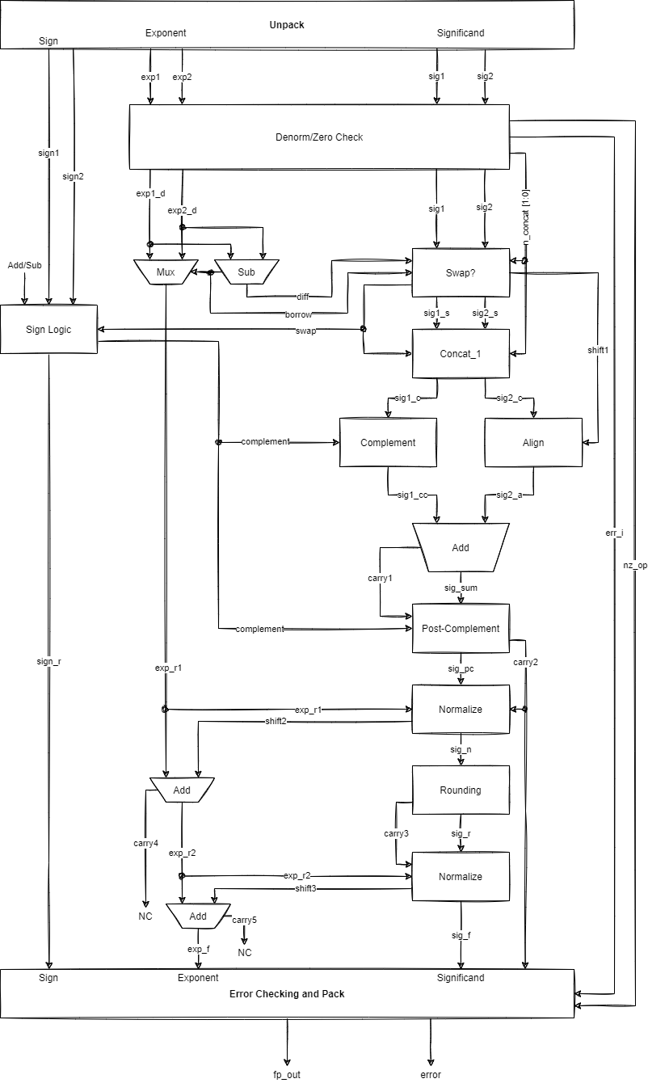
F.P. Addition And Subtraction
Notes:
Chuck: We started with the image on the left taken from our research, but we eventually evolved our design to the one on the right through lots of iterations of testing and design discussions between Bhagi and I. We decided to implement everything combinationally since we didn’t want to deal with sequential logic. This is different from how the other half of our group decided to do it which was with sequential logic. We developed each module in the diagram on the right individually and connected them all together with the wires in between. Creating this map was very helpful in analyzing and constructing our final adder/subtractor.

Slide 9
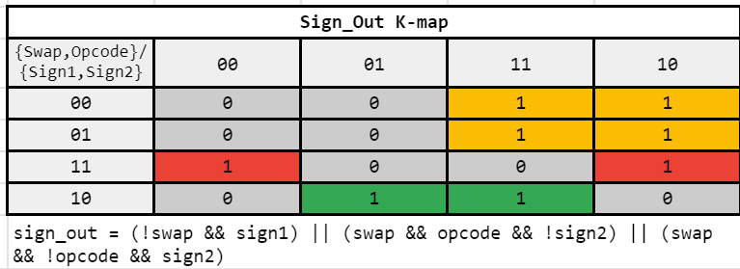
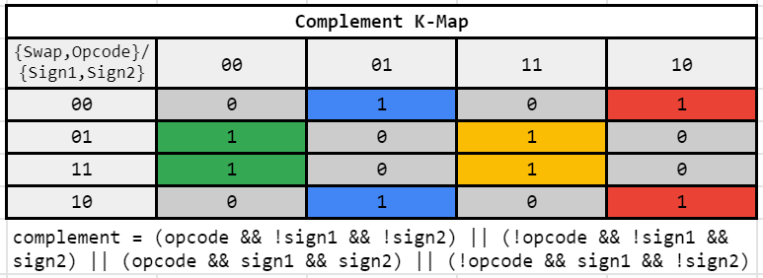
Add/Sub HW - Sign Logic
Sign and Complement Logic
Inputs |  |  |  | Outputs
Op2 > Op1 | Add/Sub Op | Sign1 | Sign2 | Sign_Out | Complement?
0 | 0 | 0 | 0 | 0 | 0
0 | 0 | 0 | 1 | 0 | 1
0 | 0 | 1 | 0 | 1 | 1
0 | 0 | 1 | 1 | 1 | 0
0 | 1 | 0 | 0 | 0 | 1
0 | 1 | 0 | 1 | 0 | 0
0 | 1 | 1 | 0 | 1 | 0
0 | 1 | 1 | 1 | 1 | 1
1 | 0 | 0 | 0 | 0 | 0
1 | 0 | 0 | 1 | 1 | 1
1 | 0 | 1 | 0 | 0 | 1
1 | 0 | 1 | 1 | 1 | 0
1 | 1 | 0 | 0 | 1 | 1
1 | 1 | 0 | 1 | 0 | 0
1 | 1 | 1 | 0 | 1 | 0
1 | 1 | 1 | 1 | 0 | 1
Notes:
Chuck: To design the sign logic we created a truth table that depended on whether operand 2 was larger than operand 1 in which case we needed to switch the operands in hardware, the opcode (0 for add, 1 for subtract), and the signs of each operand. Depending on these values we can determine the output sign bit, and it also sends a signal to some modules to complement and post complement values, such as in the case where the there is subtraction between the two operands that results in a decrease in magnitude.

Slide 10
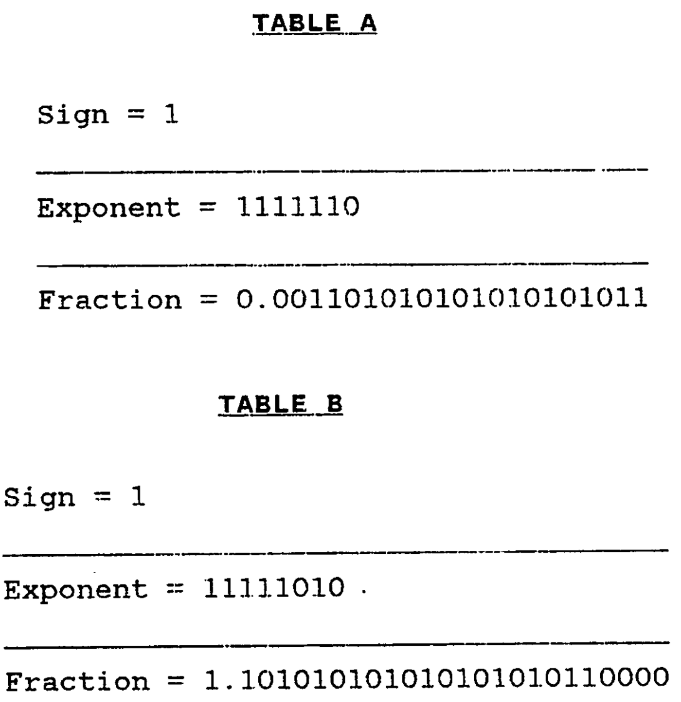
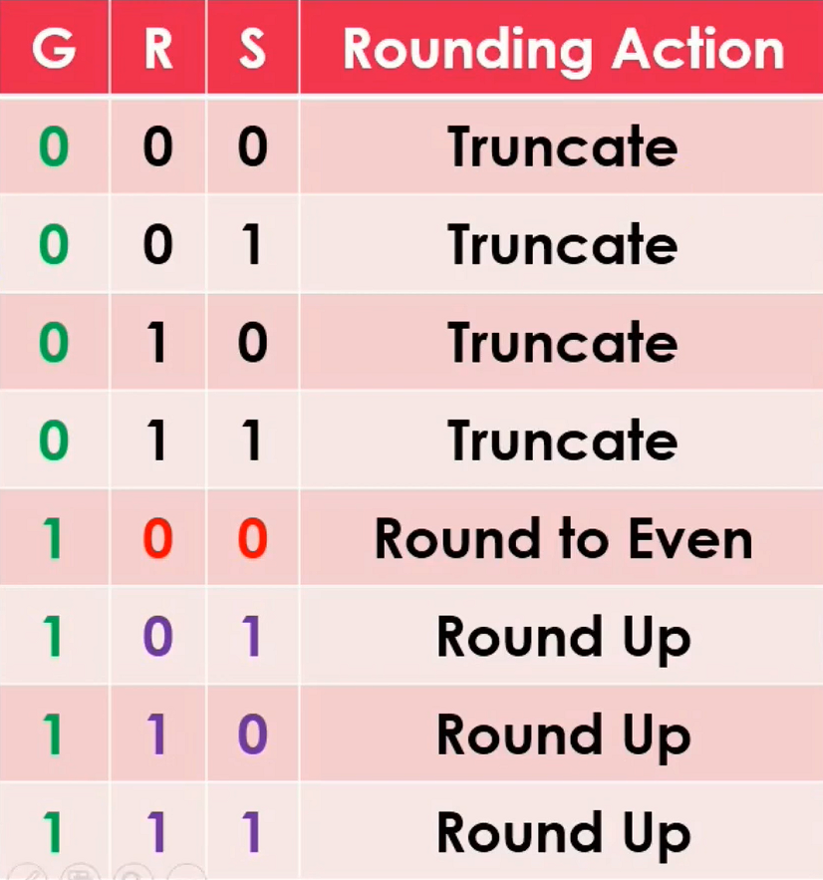
Normalization and Rounding
Once the significands are added/subtracted and complemented as needed, they are normalized
Normalization is a process performed on a binary number except zero where exponent is adjusted so that radix falls onto the right of the leftmost bit 1
Floating point computation result is often not equal to the “true” result.
Rounding is performed to choose the result with least error using the rounding bits.
Notes:
Bhagi

Slide 11
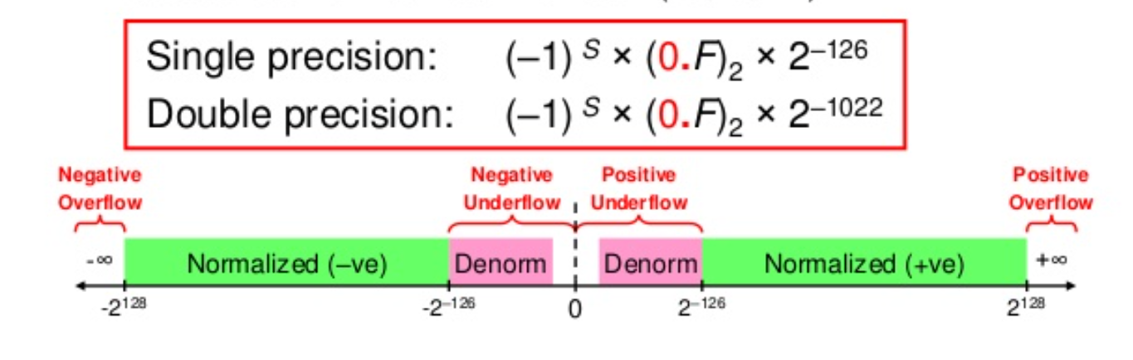
Denormalized Numbers
IEEE standard uses denormalized numbers to fill the gap between 0 and smallest normalized float and provide gradual underflow to zero
Exponent field is 0 and fraction != 0
No implicit leading 1
We specified that our design should handle denormalized numbers and this complicated our design further.
Notes:
Bhagi

Slide 12
Multiply / Divide Design Details

Slide 13
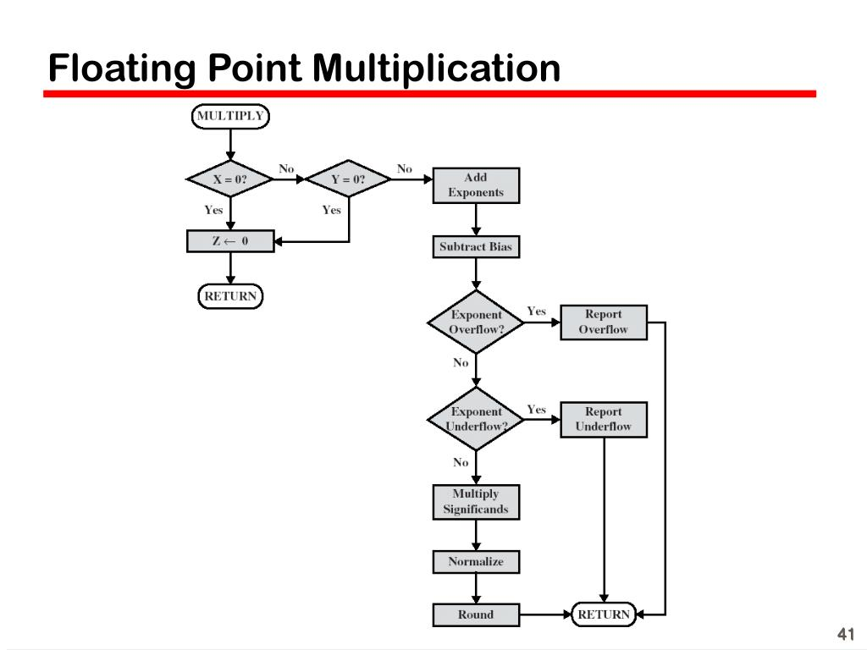
Floating point Multiplication
Notes:
Keerthan

Slide 14
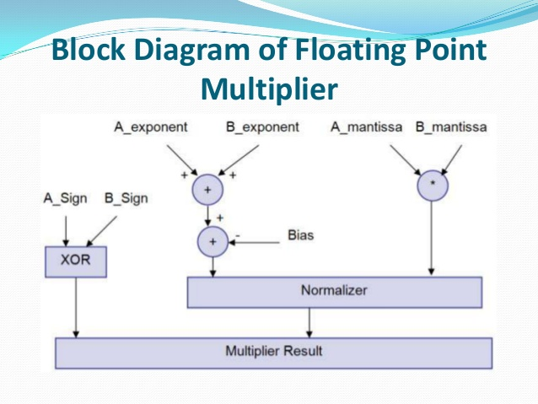
Notes:
Keerthan

Slide 15
Divider
Floating point division: a/b = (a_{s}/b_{s})*2^{(ae - be)}
Significand division: (a_{s}/b_{s}) - use Newton Raphson Method
(a/b) ~ (a*(1/b))
f(x), find x such that f(x) ~ 0
Start with x₀, then use tangential equation y-f(x₀)=0
The equation is continually iterated: x_{i+1}= x_{i}(2-x_{i}b)
q=a*x_{n}
Notes:
Ram

Slide 16
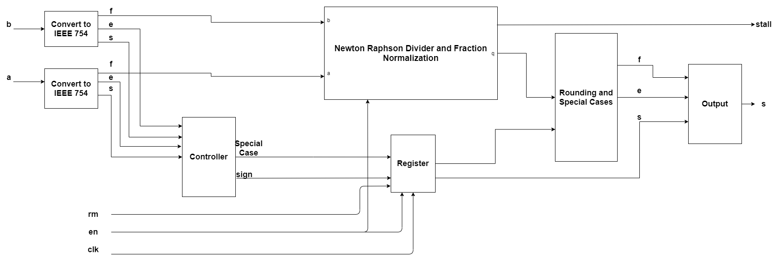
Divider Design
Notes:
Ram

Slide 17
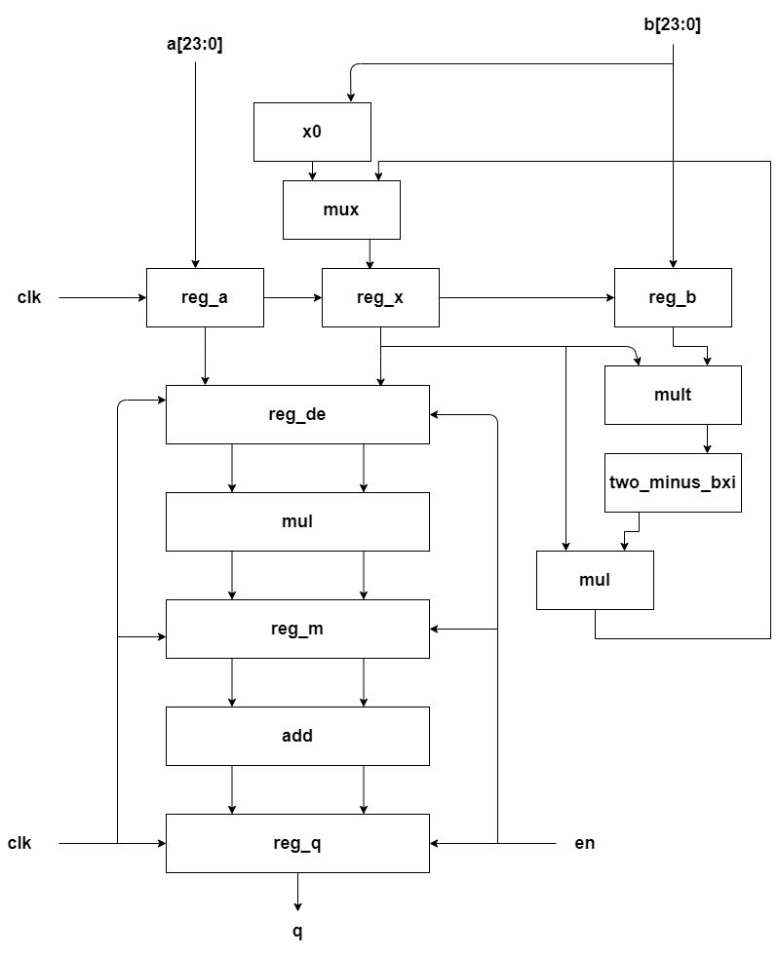
Newton Raphson Method
Notes:
Ram:

Slide 18
Exception and Error Handling
As a group we wanted to implement the following 5 error outputs:
INVALID
DIVBYZERO
OVERFLOW
UNDERFLOW
NONE
The error signal is determined based on the output exponent and significand bits.
INVALID - NaN
OVERFLOW - Infinity or Overflow
UNDERFLOW - Denormalized Number
Notes:
Bhagi: Decided on 6 standard output errors from our research: NONE, INVALID, DIVBYZERO, OVERFLOW, UNDERFLOW, INEXACT. (we didn’t even implement inexact)

Slide 19
Design Verification

Slide 20
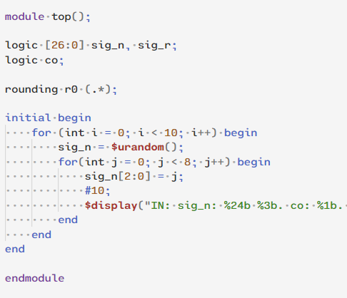
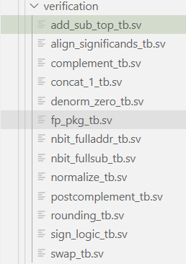
Independent Testing of Add/Sub Modules
Testing Rounding Module with Simple TB
Hierarchical Referencing of Signals was very useful
Notes:
Bhagi: We designed a lot of smaller modules. Each module itself isn’t too complicated, but we wanted to verify each module before connecting them all together into the larger adder/subtractor.

Slide 21
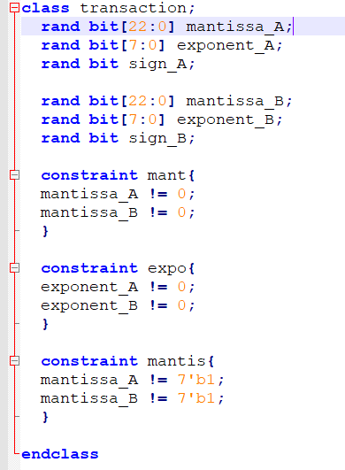
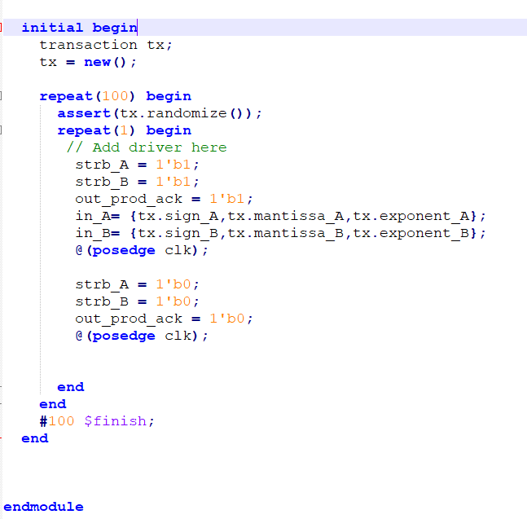
Multiply/Divide Testing Process
Notes:
Keerthan/Ram:

Slide 22
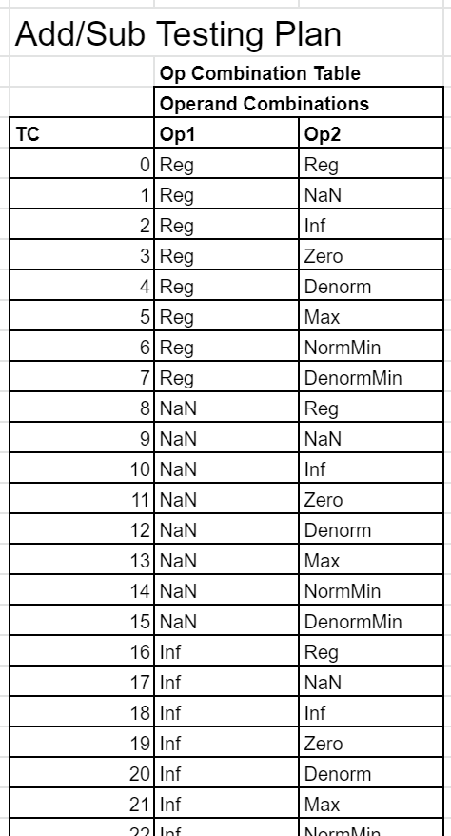
Directed Randomization Approach
Special Cases | exponent | significand
MAX | 11111110 | 11111111111111111111111
NORM_MIN | 00000001 | 00000000000000000000000
DENORM_MIN | 00000000 | 00000000000000000000001
INF | 11111111 | 00000000000000000000000
NaN | 11111111 | non-zero
DENORM_MIN | 00000000 | non-zero
ZERO | 00000000 | all zeros
8 Special Cases
64 Possible Combinations
Randomized Operands where Possible
Test all sign combinations
Notes:
Chuck: We wanted to make sure we tested all combinations of corner cases. There were 8 corner cases in total (one not really being a corner case). We developed a table and tried to identify the likely output for each operation. But because of how we implemented the testbench with objects it turned out we didn’t need to do that. For each operand

Slide 23
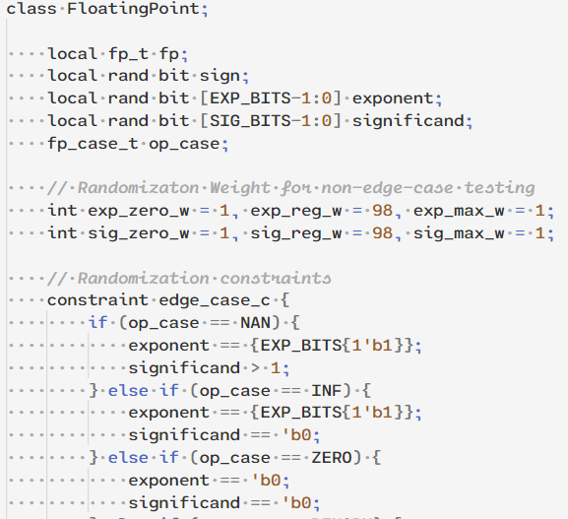
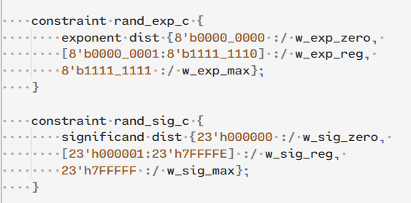
FloatingPoint Object and Constrained Random
Notes:
Chuck:

Slide 24
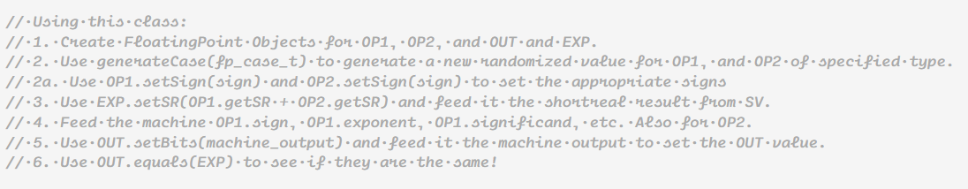
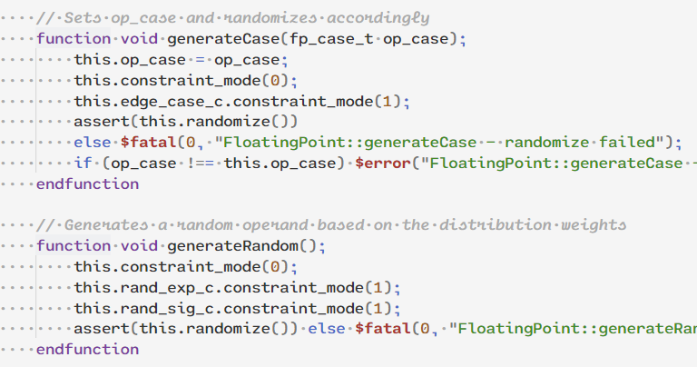
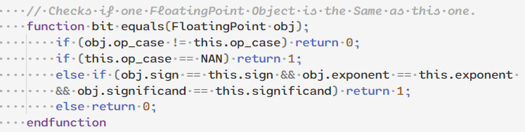
Testing Method with FloatingPoint Class
Notes:
Chuck:

Slide 25
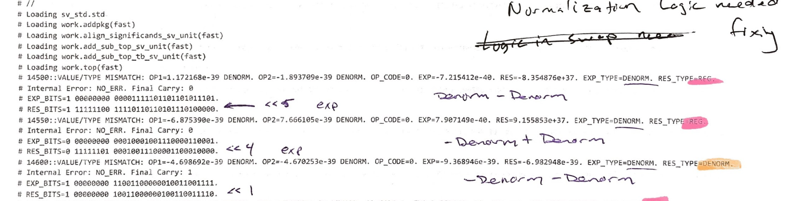
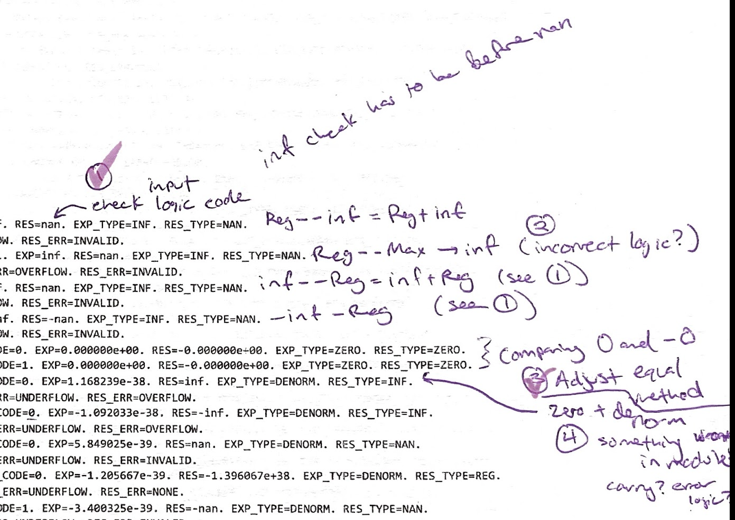
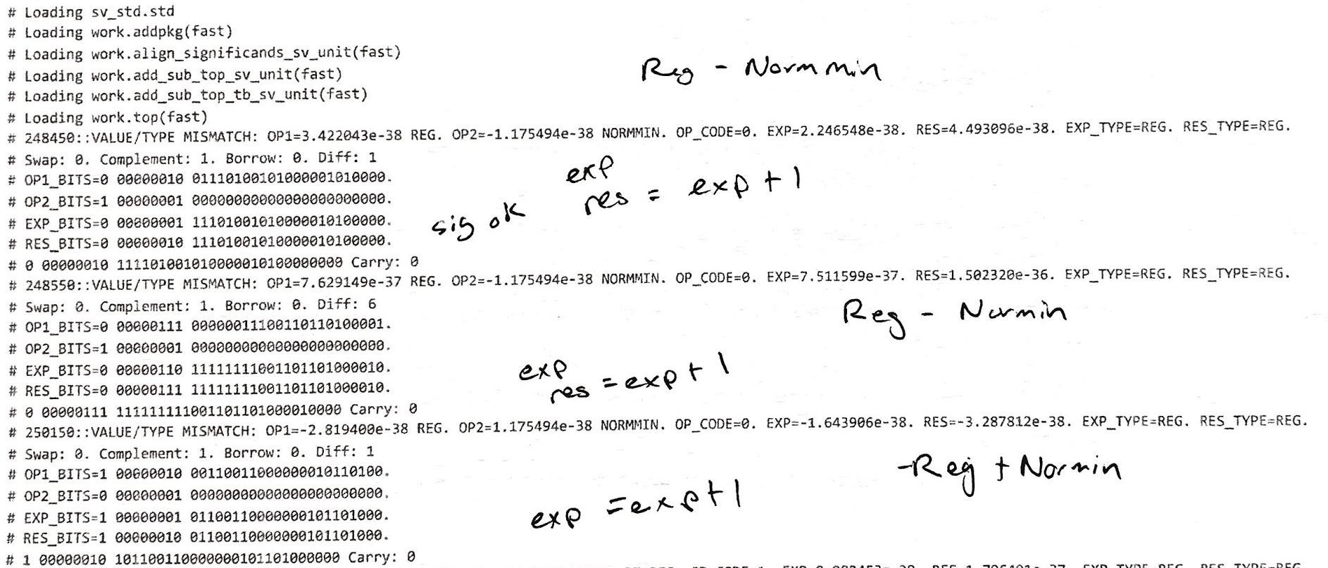
Debugging Process
Notes:
Chuck: As part of our debugging process we would run the exhaustive testbench and get hundreds of errors. We would print these error logs out, and attempt to find the patterns in the errors, to identify where the error originated from. This caught a lot of errors, particular in special cases, like zero plus or minus a number, adding two max values, normmin-denorms, etc.
We printed out the error transcripts, and tried to pinpoint the type of error that was occurring (i.e. what were the type cases, and are we adding/subtracting? etc.)
We found that we needed to include some special case handling of the inputs and of the outputs.
We also fixed some problems we had in the logic for our normalization unit and some of the things we were trying to do with the carry signals.
We addressed each problem one by one, and each time we fixed a problem, the total number of errors typically reduced by half each time, until we had no errors.
We set the total number of tests to do for each edge case to larger and larger numbers. We often found more errors and continued fixing them (sometimes through trial and error) until it worked.

Slide 26
SystemVerilog Constructs

Slide 27
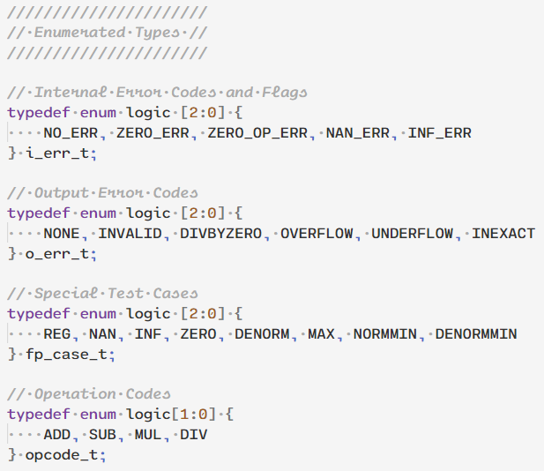
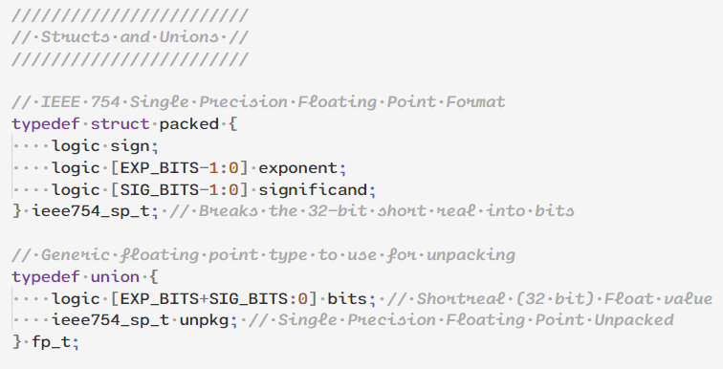
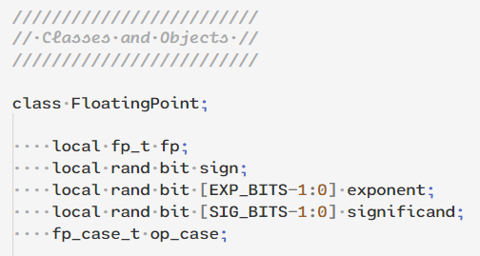
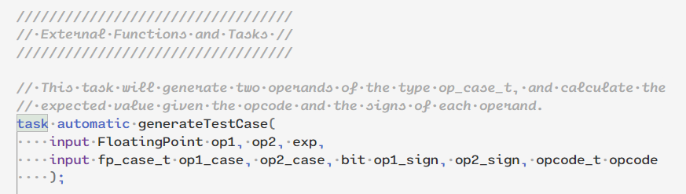
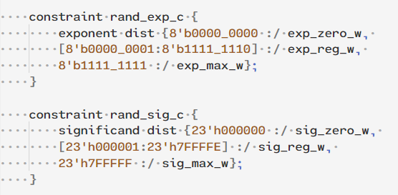
Shared Package
Enumerated Types
Structs and Unions
Classes and Methods
Functions and Tasks
Constraints
Parameterization
Notes:
Ram: We implemented most of our SystemVerilog constructs within the shared package fp_pkg, which included

Slide 28
Results
Our best results of our testing of each unit and the full unit are follows:
ADD/SUB with Randomized Operands: 58 errors / 512K tests (0.01% fr)
ADD/SUB with Directed Randomized Corner Cases: 02 errors / 512K tests (0.0004% fr)
MULT with Randomized Operands: Unavailable
MULT with Directed Randomized Corner Cases: Unavailable
DIV with Randomized Operands: 61k errors / 512k tests (8-10%)
DIV with Directed Randomized Corner Cases: 23k errors / 256k tests (8%-10%)
Notes:
ALL:

Slide 29
Remaining Error Characterization
ADD/SUB - Type 1: Off by one LSB (Rounding?). Type 2: Underflow Shifted Left 1
54 of the errors out of 512K of this type
4 of the errors out of 512K of this type
DIV - Exhibits rounding error
Notes:
ALL: For the Add/Sub randomized tests, the remaining errors are of two types. One where the LSB is off by one. This one is hard to pin down so far since it seems like it would be a rounding error, but it’s not following the rules we expect. It’s possible SV treats rounding a little differently than we expected. A very small percentage of the errors occur when the expected result of the subtraction of two regular values is to be a denorm. Things look very close but the significand is shifted by 1 to the right. While neither error is ideal, we feel the first is mostly okay because the value difference is very small and the error is rare. And the second error happens extremely rarely.

Slide 30
Next Steps
Add/Sub - Track down the off by 1 error. Track down the rare denorm error.
Mult - The multiplier code which was not working at the time of presentation is now fixed. Slides are added below regarding the fix. The test bench doesn’t exhaustively test the design and can be further improved.
Div - The divider currently exhibits the rounding problem so the output displayed is always 1 bit lesser than the expected value. Pipeline the design so it facilitates easy integration with RISCV processor.
Full FPU - Fully implement design with multiplication and more tests. Maybe in the future implement FPU into RISC-V Processor.
Notes:
ALL:

Slide 31
RISC-V Processor Implementation
Parallel exploration were conducted on finding on the appropriate RISC-V core to embed our FP processor.
Few of the cores which were considered are:
Steel Core (link): Steel is a RISC-V processor core that implements the RV32I and Zicsr instruction sets of the RISC-V specifications with 3 stage RISC pipeline.
Kronos RISC-V (link): It is again a 3 stage pipelined processor with integration an demo steps available.
Rocket Core (link): It is a 5 stage pipelined processor with a integer unit and option FPU. Planned to replace the existing one with our core.
Notes:
Ram:

Slide 32
References
Dawson, Bruce. “Exceptional Floating Point”. Apr 2012. Random Ascii Tech Blog. https://randomascii.wordpress.com/2012/04/21/exceptional-floating-point/
Fog, Agner. Floating point exception tracking and NAN propagation. Technical University of Denmark. Apr 2020. https://www.agner.org/optimize/nan_propagation.pdf
“Introduction to Floating Point Arithmetic | Rounding using Guard, Round and Sticky bits [English]”. https://www.youtube.com/watch?v=4VU7ctvMRfs
Miller, Karen. “Floating Point Representation”. http://pages.cs.wisc.edu/~markhill/cs354/Fall2008/notes/flpt.apprec.html.
Parhami, Behrooz. “Number Representation and Computer Arithmetic”. Encyclopedia of Information Systems. 2003.
Shanthi, A.P. “Floating Point Arithmetic Unit”. Computer Architecture. https://www.cs.umd.edu/~meesh/411/CA-online/chapter/floating-point-arithmetic-unit/index.html
Notes:
Bhagi:

Slide 33
Fixed the multiplier
The problem was in the testbench and not the design. I had accidentally added an always in front of the reset which means the reset was toggling along with the clock. I missed observing this initially as I didn’t pull the reset signal . Hence the multiplier was reset after every cycle and showed an X at the output. Also , I had asserted the output acknowledge without any delay(same time as the input). I have fixed the testbench and the design is working as expected now.

Slide 34
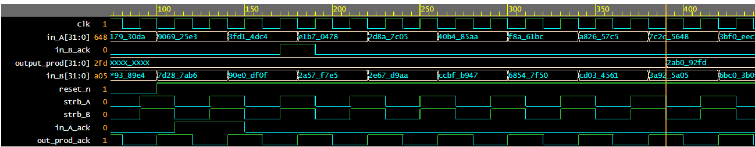
Post presentation Fix

Slide 35
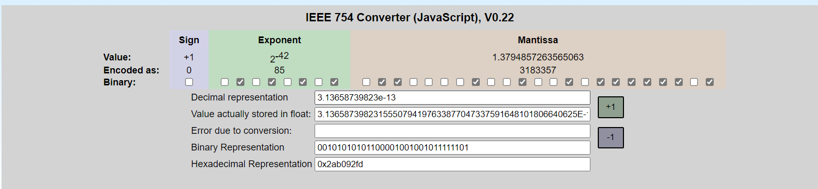
The product in binary is 0___01010101____01100001001001011111101

